Slide 1
Linux Kernel
Lecture 4:
Linux Kernel Scheduling Framework

Slide 2
History of Linux Scheduler
Linux version 1.2
Used circular queue for runnable task management
Round-robin
Efficient for adding and removing processes
Fast and simple
Linux version 2.2
Introduced the idea of scheduling class
Permitting scheduling policies for
Real-time tasks
Non-preemptible tasks
Non-real time task

Slide 3
History of Linux Scheduler
Linux version 2.4
Divided time into epochs
Within each epoch, every task was allowed to execute up to its time slice
Applying goodness function to determine which task to execute next
Simple, O(N), inefficient, lack of scalability, weak for real-time systems
Linux version 2.6
Kept track runnable tasks in a run queue (O(1) scheduler)
Capable to identify I/O or processor-bound tasks
Large mass of code in the Kernel
Exchanged with CFS-based (Completely Fair Scheduler) scheduler in 2.6.23

Slide 4
Scheduling Goals
O(1) or O(logN) scheduling; 2.4 scheduler iterated through
Run queue on each invocation
Task queue at each epoch
Scale well on multiple processors
per-CPU run queues
SMP affinity
Interactivity boost
Fairness
Optimize for one or two runnable processes

Slide 5
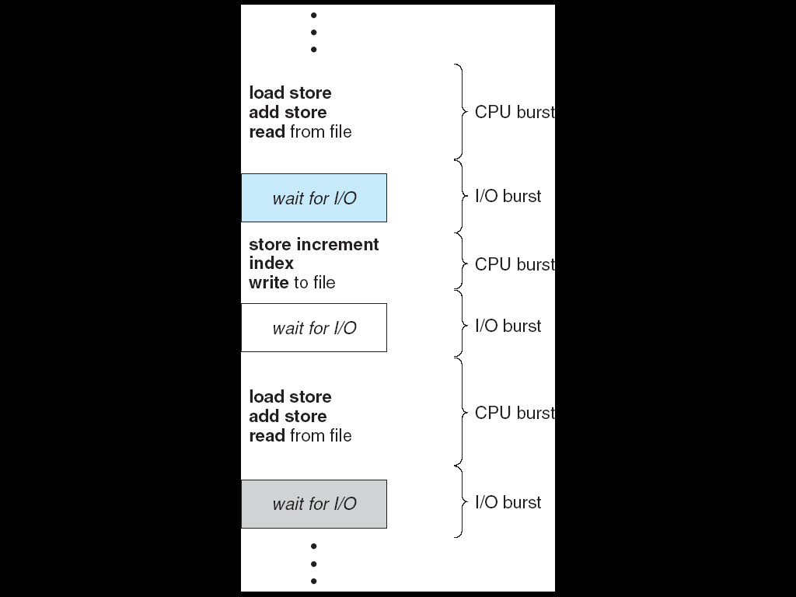
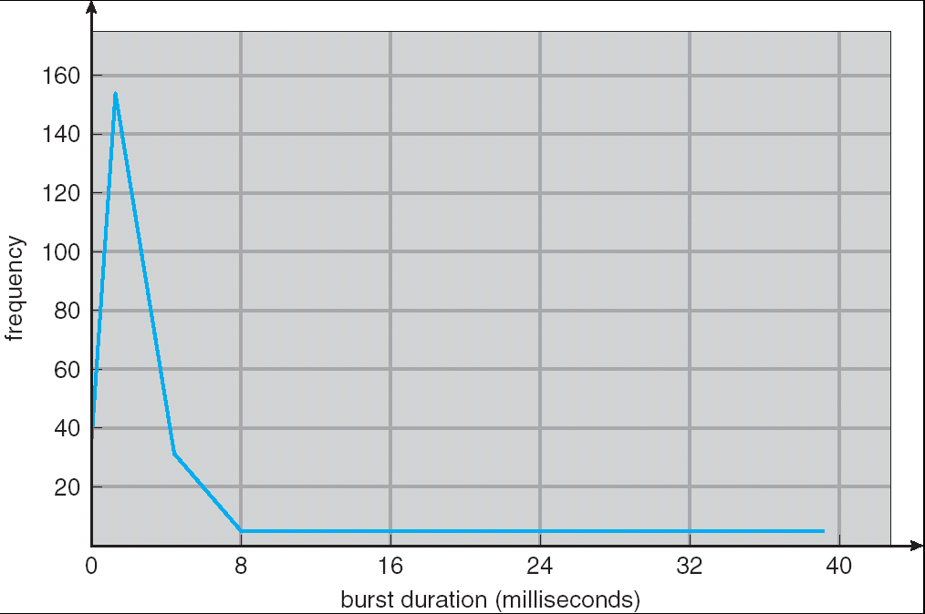
Assumption – CPU Bursts
Weighted toward small bursts
Execution model: programs alternate between bursts of CPU and I/O
Program typically uses the CPU for some period of time, then does I/O, then uses CPU again
Each scheduling decision is about which job to give to the CPU for use by its next CPU burst
With timeslicing, thread may be forced to give up CPU before finishing current CPU burst

Slide 6
How to Handle Simultaneous Mix of Diff Types of Apps?
Can we use Burst Time (observed) to decide which application gets CPU time?
Consider mix of interactive and high throughput apps:
How to best schedule them?
How to recognize one from the other?
Do you trust app to say that it is “interactive”?
Should you schedule the set of apps identically on servers, workstations, pads, and cellphones?
Assumptions encoded into many schedulers:
Apps that sleep a lot and have short bursts must be interactive apps – they should get high priority
Apps that compute a lot should get low(er?) priority, since they won’t notice intermittent bursts from interactive apps
Hard to characterize apps:
What about apps that sleep for a long time, but then compute for a long time?
Or, what about apps that must run under all circumstances (say periodically)

Slide 7
Basic Philosophies
Priority is the primary scheduling mechanism
Priority is dynamically adjusted at run time
Processes denied access to CPU get increased
Processes running a long time get decreased
Try to distinguish interactive processes from non-interactive
Bonus or penalty reflecting whether I/O or compute bound
Use large quanta for important processes
Modify quanta based on CPU use
Quanta != clock tick
Associate processes to CPUs
Do everything in O(1) time

Slide 8
Scheduling Policy
An alternative classification distinguishes three classes of processes:
Interactive processes
UI, Terminal windows, Browser, Html5
Batch processes
Science computing, Hadoop Map/Reduce, Video Coding
Real-time processes
Key kernel Threads: migration, watchdog

Slide 9
Scheduling classes
SCHED_FIFO
A First-In, First-Out real-time process. When the scheduler assigns the CPU to the process, it leaves the process descriptor in its current position in the runqueue list.
SCHED_RR
A Round Robin real-time process. When the scheduler assigns the CPU to the process, it puts the process descriptor at the end of the runqueue list.
SCHED_NORMAL
A conventional, time-shared process.

Slide 10
Scheduling of User Processes
static priority
User process with a number ranging from 100 (highest priority) to 139 (lowest priority)
Realtime process with a number ranging from 0-99
Kernel/Realtime Tasks
User Tasks
0
100
139

Slide 11
The Run Queue
140 separate queues, one for each priority level
Actually, two sets, active and expired
Priorities 0-99 for real-time processes
Priorities 100-139 for normal processes; value set via nice() system call

Slide 12
Scheduler Runqueue
A scheduler runqueue is a list of tasks that are runnable on a particular CPU.
A rq structure maintains a linked list of those tasks.
The runqueues are maintained as an array runqueues, indexed by the CPU number.
The rq keeps a reference to its idle task
The idle task for a CPU is never on the scheduler runqueue for that CPU (it's always the last choice)
Access to a runqueue is serialized by acquiring and releasing rq->lock

Slide 13
Basic Scheduling Algorithm
Find the highest-priority queue with a runnable process
Find the first process on that queue
Calculate its quantum size
Let it run
When its time is up, put it on the expired list
Repeat

Slide 14
The Highest Priority Process
There is a bit map indicating which queues have processes that are ready to run
Find the first bit that’s set:
140 queues → 5 integers
Only a few compares to find the first that is non-zero
Hardware instruction to find the first 1-bit
bsfl on Intel
Time depends on the number of priority levels, not the number of processes

Slide 15
Scheduling Components
Static Priority
Sleep Average
Bonus
Interactivity Status
Dynamic Priority

Slide 16
Static Priority
Each task has a static priority that is set based upon the nice value specified by the task.
static_prio in task_struct
conventional process with a number ranging from 100 (highest priority) to 139 (lowest priority)
Real-time process with a number ranging from 0-99
The nice value is in a range of 0 to 39, with the default value being 20. Only privileged tasks can set the nice value below 20.
For normal tasks, the static priority is 100 + the nice value.
Each task has a dynamic priority that is set based upon a number of factors

Slide 17
Calculating Basic Quanta (Time Slices)
time_slice in the task_struct
Calculate Quanta (ms) where
If (SP < 120): Quanta = (140 − SP) × 20
if (SP >= 120): Quanta = (140 − SP) × 5
where SP is the static priority
Basic idea: important processes should run longer
As we will see, other mechanisms are used for quick interactive response

Slide 18
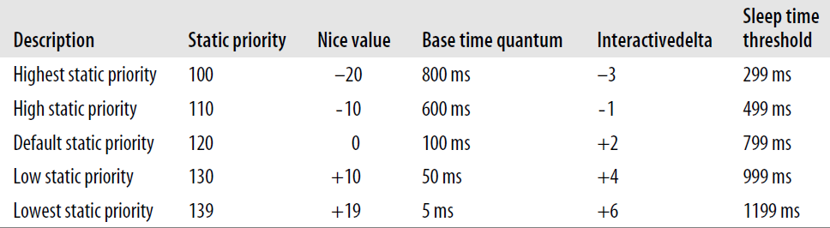
Calculating Basic Time Slices
Higher priority process get longer quanta

Slide 19
Dynamic Priority & Bonus
/* We scale the actual sleep average
* [0 .... MAX_SLEEP_AVG] into the
* 0 ... 5 ... 10 bonus/penalty range.
The dynamic priority is the number actually looked up by the scheduler when selecting the new process to run.
Dynamic priority (prio in task_struct) is calculated in effective_prio from static priority and bonus (which in turn is derived from sleep_avg)
Roughly speaking, the bonus is a number in [0, 10] that measures what percentage of the time the process was sleeping recently; =5 is neutral, >5 helps, < 5hurts:
step1: DP = SP − bonus + 5
step2: DP = max(100, min(139, DP))

Slide 20
Sleep Average
Roughly, the average sleep (a_s) time is the average number of nanoseconds that the process spent while sleeping.
Interactivity heuristic: sleep ratio
Mostly sleeping: I/O bound
Mostly running: CPU bound
Sleep ratio approximation
sleep_avg in the task_struct
Range: 0 .. MAX_SLEEP_AVG (10 ms)
Interactive ?
dynamic priority ≤ 3 × static priority / 4 + 28
Equals:
bonus - 5 ≥ static priority / 4 − 28
Interactive δ =static priority / 4 − 28
Interactive process with: sp=100, bonus >=2 , a_s time >= 200ms

Slide 21
Typical time quanta
Priority: | Static Pri | Niceness | Time quanta
Highest | 100 | -20 | 800 ms
High | 110 | -10 | 600 ms
Normal | 120 | 0 | 100 ms
Low | 130 | 10 | 50 ms
Lowest | 139 | 20 | 5 ms

Slide 22
Sleep Time and Bonus
Average Sleep Time (ms) | Bonus | Time quanta Granularity
000 to 100 | 0 | 5120
100 to 200 | 1 | 2560
200 to 300 | 2 | 1280
300 to 400 | 3 | 640
400 to 500 | 4 | 320
500 to 600 | 5 | 160
600 to 700 | 6 | 80
700 to 800 | 7 | 40
800 to 900 | 8 | 20
900 to 999 | 9 | 10
1 second | 10 | 10

Slide 23
Interactive Processes
A process is considered interactive if
bonus − 5 >= (Static Priority / 4) − 28
Low-priority processes have a hard time becoming interactive:
A high static priority (100) becomes interactive when its average sleep time is greater than 200 ms
A default static priority process becomes interactive when its sleep time is greater than 700 ms
Lowest priority (139) can never become interactive
The higher the bonus the task is getting and the higher its static priority, the more likely it is to be considered interactive.

Slide 24
Avoiding Starvation
The system only runs processes from active queues, and puts them on expired queues when they use up their time slice
When a priority level of the active queue is empty, the scheduler looks for the next-highest priority queue
After running all of the active queues, the active and expired queues are swapped
There are pointers to the current arrays; at the end of a cycle, the pointers are switched

Slide 25
Using Time Slice
At every time tick (in scheduler_tick) , decrement the quanta of the current running process (time_slice)
If the time goes to zero, the process is done
Check interactive status:
If non-interactive, put it aside on the expired list
If interactive, put it at the end of the active list
Exceptions: don’t put on active list if:
If higher-priority process is on expired list
If expired task has been waiting more than STARVATION_LIMIT
If there’s nothing else at that priority, it will run again immediately
Of course, by running so much, its bonus will go down, and so will its priority and its interactive status

Slide 26
The Priority Arrays
struct prio_array {
unsigned int nr_active;
unsigned long bitmap[5];
struct list_head queue[140];
};
struct rq {
spinlock_t lock;
unsigned_long nr_running;
struct prio_array *active, *expired;
struct prio_array arrays[2];
task_struct *curr, *idle;
…
};

Slide 27
Swapping Arrays
struct prioarray *array =
rq->active;
if (array->nr_active == 0) {
rq->active = rq->expired;
rq->expired = array;
}

Slide 28
Active and expired processes
priority array
Higher priority more I/O
800ms quanta
priority queue
active
.
.
.
.
.
.
priority queue
lower priority more CPU
10ms quanta
expired
priority array
priority queue
.
.
.
.
.
.
priority queue
Notes:
Why ?

Slide 29
Scheduler runqueue
The basic data structure in the Linux scheduler is runqueue, located at kernel/sched.c
struct runqueue {
spinlock_t lock; /* spin lock that protects this runqueue */
unsigned long nr_running; /* number of runnable tasks */
unsigned long nr_switches; /* context switch count */
unsigned long expired_timestamp; /* time of last array swap */
unsigned long nr_uninterruptible; /* uninterruptible tasks */
unsigned long long timestamp_last_tick; /* last scheduler tick */
struct task_struct *curr; /* currently running task */
struct task_struct *idle; /* this processor's idle task */
struct mm_struct *prev_mm; /* mm_struct of last ran task */
struct prio_array *active; /* active priority array */
struct prio_array *expired; /* the expired priority array */
struct prio_array arrays[2]; /* the actual priority arrays */
struct task_struct *migration_thread; /* migration thread */
struct list_head migration_queue; /* migration queue*/
atomic_t nr_iowait; /* number of tasks waiting on I/O */
};

Slide 30
Scheduler Data Structure and Variables
There are a group of macros work with runqueue associated with given processor or process
cpu_rq(processor)
this_rq() /* returns the runqueue of the current processor */
task_rq(task) /* returns a pointer to the runqueue associated with the given task */

Slide 31
Scheduler Data Structure and Variables
Each runqueue contains two priority arrays, active and expired
Defined in kernel/sched.c as struct prio_array
Each priority array contains one queue keeping list of runnable processes at each priority level
struct prio_array {
int nr_active;
/* number of tasks in the queues */
unsigned long bitmap[BITMAP_SIZE];
/* priority bitmap */
struct list_head queue[MAX_PRIO];
/* priority queues */
};

Slide 32
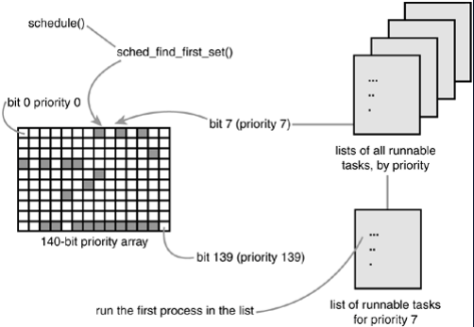
Scheduler Data Structure and Variables

Slide 33
Scheduling Fairness
What about fairness?
Strict fixed-priority scheduling between queues is unfair (run highest, then next, etc):
long running jobs may never get CPU
In Multics, shut down machine, found 10-year-old job
Must give long-running jobs a fraction of the CPU even when there are shorter jobs to run
Tradeoff: fairness gained by hurting avg response time!
How to implement fairness?
Could give each queue some fraction of the CPU
What if one long-running job and 100 short-running ones?
Like express lanes in a supermarket—sometimes express lanes get so long, get better service by going into one of the other lines
Could increase priority of jobs that don’t get service
What is done in some variants of UNIX
This is ad hoc—what rate should you increase priorities?
And, as system gets overloaded, no job gets CPU time, so everyone increases in priority⇒Interactive jobs suffer

Slide 34
Linux Completely Fair Scheduler (CFS)
First appeared in 2.6.23, modified in 2.6.24
“CFS doesn’t track sleeping time and doesn’t use heuristics to identify interactive tasks—it just makes sure every process gets a fair share of CPU within a set amount of time given the number of runnable processes on the CPU.”
Inspired by Networking “Fair Queuing”
Each process given their fair share of resources
Models an “ideal multitasking processor” in which N processes execute simultaneously as if they truly got 1/N of the processor
Tries to give each process an equal fraction of the processor
Priorities reflected by weights such that increasing a task’s priority by 1 always gives the same fractional increase in CPU time – regardless of current priority

Slide 35
CFS (Continued)
Idea: track “virtual time” received by each process when it is running
Take real execution time, scale by weighting factor
Lower priority ⇒ real time divided by greater weight
Actually – multiply by sum of all weights/current weight
Keep virtual time advancing at same rate
Targeted latency (T_{L}): period of time after which all processes get to run at least a little
Each process runs with quantum (w_{p} / Σw_{i} )
Never smaller than “minimum granularity”
Red-Black tree holds all runnable processes sorted on vruntime
O(log n) time to perform insertions/deletions
Cache the item at far left (item with earliest vruntime)
Scheduler always takes process with smallest vruntime (far left item)

Slide 36
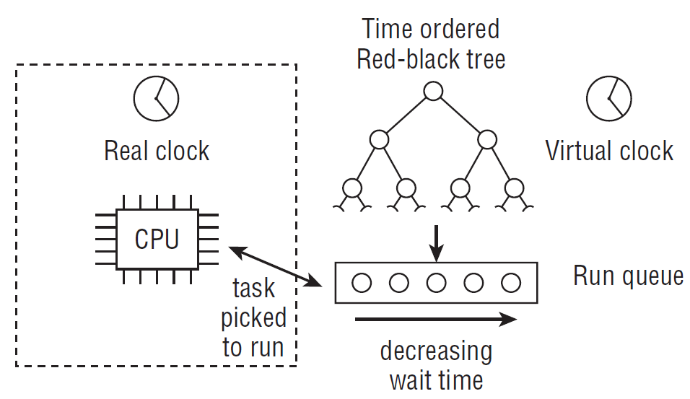
CFS Examples
The scheduler keeps track of the waiting time of the available processes by sorting them in a red-black tree

Slide 37
CFS Examples
Suppose Targeted latency = 20ms and Minimum Granularity = 1ms
Two CPU bound tasks with same priorities
Both switch with 10ms
Two CPU bound tasks separated by nice value of 5
One task gets 5ms, another gets 15ms
40 tasks: each gets 1ms (no longer totally fair – miss target latency)
One CPU bound task, one interactive task same priority
While interact task sleeps, CPU bound task runs, increments vruntime
When interact task wakes up, runs immediately (it’s behind on vruntime)
Group scheduling facilities (2.6.24)
Can give fair fractions to groups (user or other process group)
So, two users, one starts 1 process, other starts 40, each gets 50% CPU

Slide 38
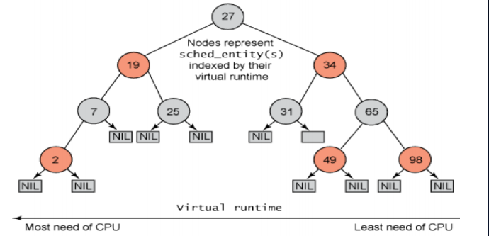
RB tree of CFS
Maintains balance in providing processor time to tasks
Uses virtual runtime concept
Maintains a time-ordered red-black tree instead of queue

Slide 39
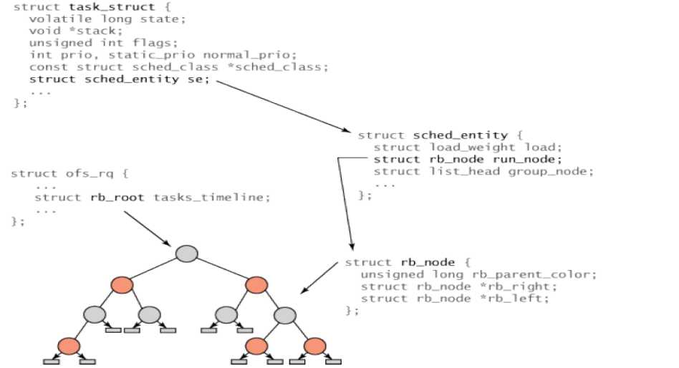
Structure Hierarchy in CFS

Slide 40
Scheduler and Policies
Scheduling policy is set by sched_setscheduler()
Scheduling policies:
SCHED_FIFO for special time-critical applications
SCHED_BATCH for CPU-intensive tasks
SCHED_IDLE for very low prioritized tasks
SCHED_OTHER default Linux time-sharing scheduling
SCHED_RR round robin scheduling

Slide 41
Scheduling Class
Linux Scheduler stored in kernel/sched.c
It is a modular scheduler, enabling different algorithms to schedule different tasks
It uses the concept of scheduling class
Each task belongs to a scheduling class, determined how a task will be scheduled
Each scheduling class defines a common set of functions to define the behavior of the scheduler

Slide 42
Schedule Classes
Two important schedule class
RT Schedule class
Defined in POSIX
Tasks with policy set to SCHED_FIFO and SCHED_RR use it
Implemented in kernel/sched_rc.c
Completely Fair Schedule class
Schedule tasks with policy set to SCHED_NORMAL (SCHED_OTHER), SCHED BATCH, SCHED_IDLE
Implemented in kernel/sched_fair.c

Slide 43
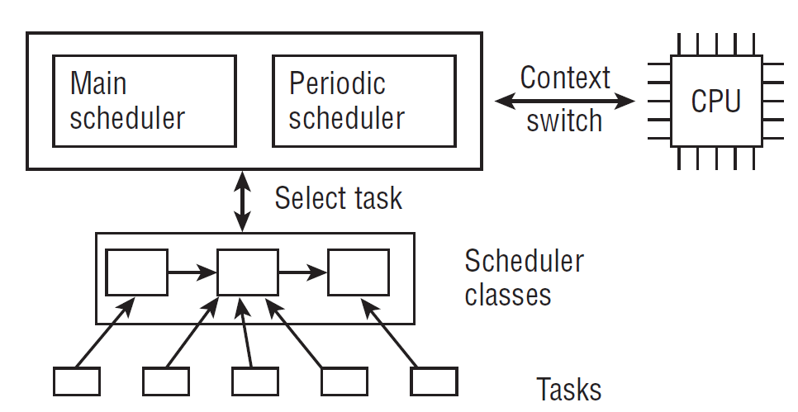
Schedule Classes
Overview of the components of the scheduling subsystem

Slide 44
Schedule Classes
<sched.h>
struct sched_class {
const struct sched_class *next;
void (*enqueue_task) (struct rq *rq, struct task_struct *p, int wakeup);
void (*dequeue_task) (struct rq *rq, struct task_struct *p, int sleep);
void (*yield_task) (struct rq *rq);
void (*check_preempt_curr) (struct rq *rq, struct task_struct *p);
struct task_struct * (*pick_next_task) (struct rq *rq);
void (*put_prev_task) (struct rq *rq, struct task_struct *p);
void (*set_curr_task) (struct rq *rq);
void (*task_tick) (struct rq *rq, struct task_struct *p);
void (*task_new) (struct rq *rq, struct task_struct *p);
};

Slide 45
CFS Schedule Class
kernel/sched_fair.c
static const struct sched_class fair_sched_class = {
.next = &idle_sched_class,
.enqueue_task = enqueue_task_fair,
.dequeue_task = dequeue_task_fair,
.yield_task = yield_task_fair,
.check_preempt_curr = check_preempt_wakeup,
.pick_next_task = pick_next_task_fair,
.put_prev_task = put_prev_task_fair,
...
.set_curr_task = set_curr_task_fair,
.task_tick = task_tick_fair,
.task_new = task_new_fair,
};

Slide 46
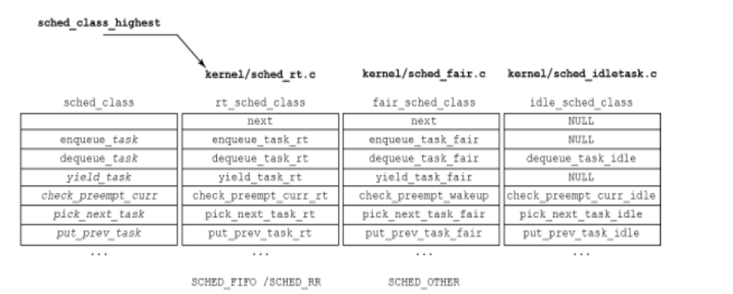
Graphical view of scheduling classes

Slide 47
Scheduler Data Structure and Variables
Process states defined in /usr/include/linux/sched.h
Five process states including:
#define TASK_RUNNING 0
#define TASK_INTERRUPTIBLE 1
#define TASK_UNINTERRUPTIBLE 2
#define TASK_ZOMBIE 4
#define TASK_STOPPED 8

Slide 48
Scheduler Data Structure and Variables
kernel/sched.c
struct cfs_rq {
struct load_weight load;
unsigned long nr_running;
u64 min_vruntime;
struct rb_root tasks_timeline;
struct rb_node *rb_leftmost;
struct sched_entity *curr;
}
nr_running counts the number of runnable processes on the queue, and load maintains the
cumulative load values of them all.
min_vruntime tracks the minimum virtual run time of all processes on the queue.
tasks_timeline is the base element to manage all processes in a time-ordered red-black tree.
curr points to the schedulable entity of the currently executing process.
Notes:
Nr_running counts the number of runnable processes on the queue, and load maintains the
cumulative load values of them all.
min_vruntime tracks the minimum virtual run time of all processes on the queue.
tasks_timeline is the base element to manage all processes in a time-ordered red-black tree.
curr points to the schedulable entity of the currently executing process.

Slide 49
CFS Operations - The Virtual Clock
static void update_curr(struct cfs_rq *cfs_rq)
{
struct sched_entity *curr = cfs_rq->curr;
u64 now = rq_of(cfs_rq)->clock;
unsigned long delta_exec;
if (unlikely(!curr))
return;
delta_exec = (unsigned long)(now - curr->exec_start);
__update_curr(cfs_rq, curr, delta_exec);
curr->exec_start = now;
}

Slide 50
CFS Operations - The Virtual Clock
kernel/sched_fair.c
static inline void
__update_curr(struct cfs_rq *cfs_rq, struct sched_entity *curr, unsigned long delta_exec)
{
unsigned long delta_exec_weighted;
u64 vruntime;
curr->sum_exec_runtime += delta_exec;
delta_exec_weighted = delta_exec;
if (unlikely(curr->load.weight != NICE_0_LOAD)) {
delta_exec_weighted = calc_delta_fair(delta_exec_weighted,
&curr->load);
}
curr->vruntime += delta_exec_weighted;
...
}
calc_delta_fair() compute the value
given by the following formula:

Slide 51

CFS Operations - The Virtual Clock
calc_delta_fair() computes the value given by the following formula:
In the formula, the virtual and physical time are identical for nice 0 tasks with priority 120, that is, if current->load.weight is NICE_0_LOAD.

Slide 52
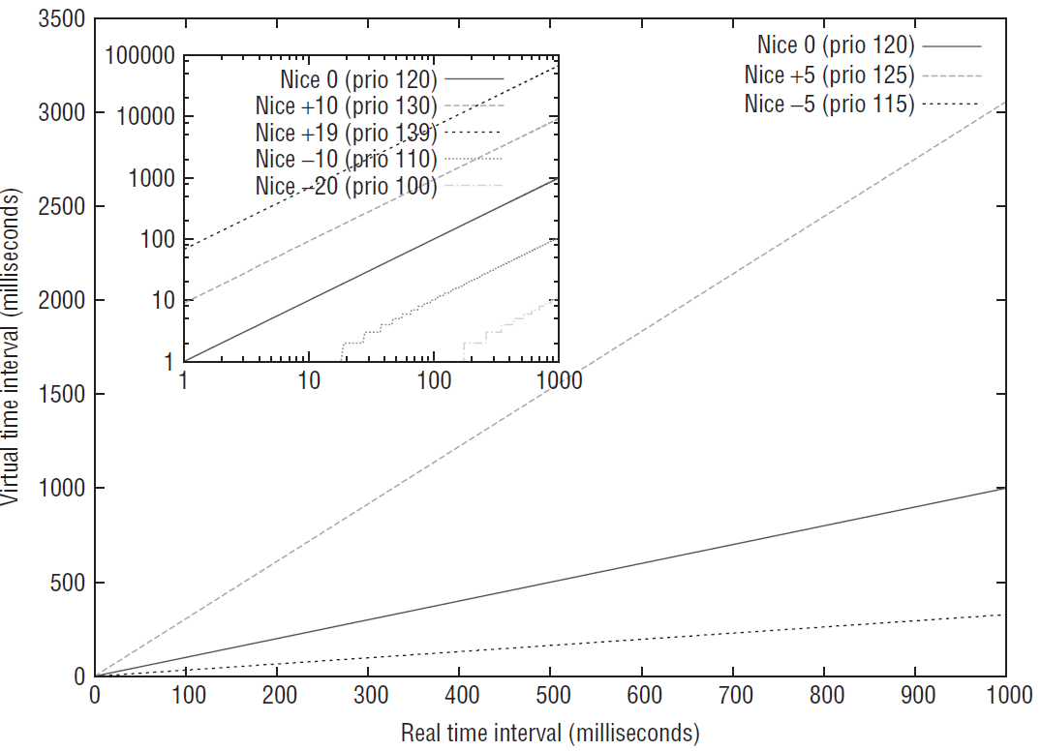
Relation between real and virtual time for processes depending on their priority/nice level

Slide 53
CFS min_vruntime increasing monotonically
kernel/sched_fair.c
/* maintain cfs_rq->min_vruntime to be a monotonically increasing
* value tracking the leftmost vruntime in the tree. */
if (first_fair(cfs_rq)) {
vruntime = min_vruntime(curr->vruntime,
__pick_next_entity(cfs_rq)->vruntime);
} else
vruntime = curr->vruntime;
cfs_rq->min_vruntime =
max_vruntime(cfs_rq->min_vruntime, vruntime);
kernel/sched_fair.c // sorting tool function in rb tree
static inline s64 entity_key(struct cfs_rq *cfs_rq, struct sched_entity *se)
{
return se->vruntime - cfs_rq->min_vruntime;
}

Slide 54
Two Antagonistic Mechanisms
When a process is running, its vruntime will steadily increase, so it will finally move rightward in the red-black tree. Because vruntime will increase more slowly for more important processes, they will also move rightward more slowly, so their chance to be scheduled is bigger than for a less important process — just as required.
If a process sleeps, its vruntime will remain unchanged. Because the per-queue min_vruntime increases in the meantime (recall that it is monotonic!), the sleeper will be placed more to the left after waking up because the key got smaller.

Slide 55
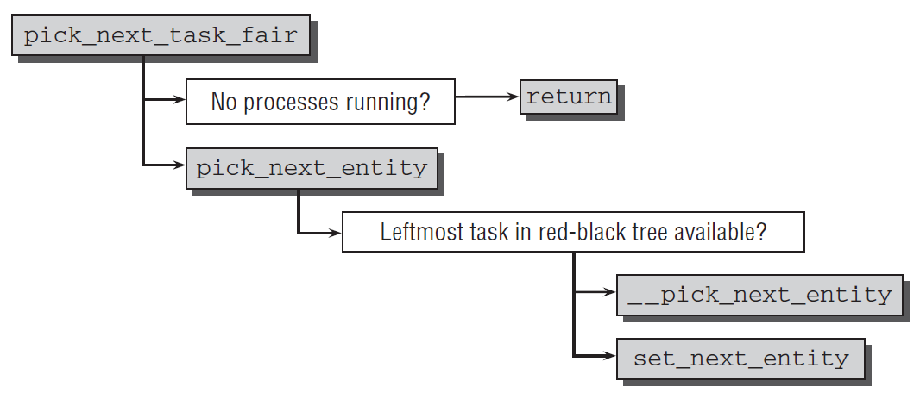
Selecting the Next Task
Selecting the next task to run is performed in pick_next_task_fair（）

Slide 56
Real-Time Scheduling
Linux supports two real-time scheduling classes in addition to ‘‘normal‘‘ processes. The structure of the scheduler enables real-time processes to be integrated into the kernel without any changes in the core scheduler — this is a definitive advantage of scheduling classes.
WHY?
kernel/sched-rt.c
const struct sched_class rt_sched_class = {
.next = &fair_sched_class,
.enqueue_task = enqueue_task_rt,
.dequeue_task = dequeue_task_rt,
.yield_task = yield_task_rt,
.check_preempt_curr = check_preempt_curr_rt,
.pick_next_task = pick_next_task_rt,
.put_prev_task = put_prev_task_rt,
.set_curr_task = set_curr_task_rt,
.task_tick = task_tick_rt,
};

Slide 57
Real-Time Scheduling
Linux has soft real-time scheduling
No hard real-time guarantees
All real-time processes are higher priority than any conventional processes
Processes with priorities [0, 99] are real-time
saved in rt_priority in the task_struct
scheduling priority of a real time task is: 99 - rt_priority
Process can be converted to real-time via sched_setscheduler system call

Slide 58
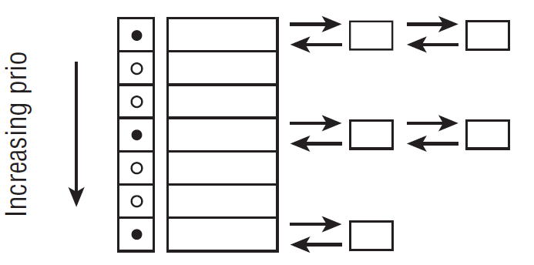
Real-Time Scheduling
kernel/sched.c
struct rt_prio_array {
DECLARE_BITMAP(bitmap, MAX_RT_PRIO+1); /* include 1 bit for delimiter */
struct list_head queue[MAX_RT_PRIO]; };
struct rt_rq { struct rt_prio_array active; };

Slide 59
Real-Time Policies
First-in, first-out: SCHED_FIFO
Static priority
Process is only preempted for a higher-priority process
No time quanta; it runs until it blocks or yields voluntarily
RR within same priority level
Round-robin: SCHED_RR
As above but with a time quanta (800 ms)
Normal processes have SCHED_OTHER scheduling policy

Slide 60
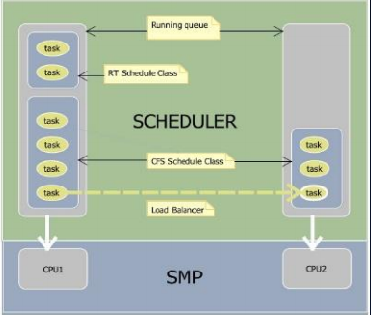
Multiprocessor Scheduling
Each processor has a separate run queue
Each processor only selects processes from its own queue to run
it’s possible for one processor to be idle while others have jobs waiting in their run queues
Periodically, the queues are rebalanced: if one processor’s run queue is too long, some processes are moved from it to another processor’s queue

Slide 61
Locking Runqueues
To rebalance, the kernel sometimes needs to move processes from one runqueue to another
This is actually done by special kernel threads
Naturally, the runqueue must be locked before this happens
The kernel always locks runqueues in order of increasing indexes
Why? Deadlock prevention!

Slide 62
Processor Affinity
Each process has a bitmask saying what CPUs it can run on
Normally, of course, all CPUs are listed
Processes can change the mask
The mask is inherited by child processes (and threads), thus tending to keep them on the same CPU
Rebalancing does not override affinity

Slide 63
appendix

